Slide 1


THE DAYS OF GENESIS
Part 2
In Defense Of Genesis
All verses are from the NKJV unless noted

Slide 2
Examples of Brethren Attacking Genesis
GENESIS

Slide 3
The Birmingham News (4/12/2002)
“One of those is Lord I Believe, a group formed 15 years ago by Hill Roberts, chief scientist at NASA and defense contractor SRS Technologies, through his church, Weatherly Heights Church of Christ… ‘My faith is that nature and the Bible both come from the same author and hence will not be in conflict,’ Roberts said. For example, Roberts doesn't see a conflict between the Bible and scientists who say the Earth is 4.5 billion years old.”

Slide 4
Where Does The Rejection Of The Literal Account Of Creation Lead?
ANSWER: The Denial Of Other Biblical Events When They Do Not Agree With Man’s Ideas!

Slide 5
Minimizing
THE UNIVERSAL FLOOD

Slide 6
Hill Roberts, “Lord I Believe” Seminar Flyer (1999)
“My mission is to show skeptic and believer alike why one can have confidence in the Bible…While I am a scientist and Christian who believes in creation, I do not promote what is generally referred to as "creation science" or "creationism". I adhere to standard science methods and scientifically reported data to evaluate the creation/evolution issue, instead of getting sidetracked over spurious hypotheses such as young earth flood geology. Scrupulous scientific integrity is the only way to approach today's scientific skeptic.”

Slide 7
“Spurious?”
“Spurious” - different from what it is claimed to be, not authentic, or not valid or well-founded
  Hill Roberts considers that “young earth flood geology” is spurious
    Opposes a creation of 6000-10000 years ago
    Endorses an old creation of billions of years
    Views those who believe a recent global-changing flood as believing something spurious
    Denies that the flood would have left a mark on the earth!
Notes:
Job 38:4, "Where were you when I laid the foundations of the earth? Tell Me, if you have understanding.

Slide 8
Hill Roberts, “Lord I Believe” Seminar Flyer (1999)
“My mission is to show skeptic and believer alike why one can have confidence in the Bible…While I am a scientist and Christian who believes in creation, I do not promote what is generally referred to as "creation science" or "creationism". I adhere to standard science methods and scientifically reported data to evaluate the creation/evolution issue, instead of getting sidetracked over spurious hypotheses such as young earth flood geology. Scrupulous scientific integrity is the only way to approach today's scientific skeptic.”

Slide 9
“Scrupulous scientific integrity is the only way to approach today's scientific skeptic.”
Today’s scientific skeptic needs humility, not scientific evidences (Job 38:4)
Today’s scientific skeptic…
  “knowing this first: that scoffers will come in the last days, walking according to their own lusts” (2 Pet. 3:3)
  “A proud and haughty man — ‘Scoffer’ is his name; He acts with arrogant pride” (Pr. 21:24; cf. Ps. 73:6; 1 Tim. 6:4)
  Without humility, no one can be reached with grace
  We should NEVER try to reach anyone by propping up man’s fallible ideas and denying God’s infallible word!

Slide 10




Slide 11
Hill Roberts, “Flood Geology” (email message, 03, 1996)
“Noah's flood was only about a year long. …Slow deposition of entrapping sediments, is a much better explanation for these deposits than rapid flood deposition…”
“He who builds His layers in the sky, And has founded His strata in the earth; Who calls for the waters of the sea, And pours them out on the face of the earth—The LORD is His name” (Amos 9:4)
Notes:
God builds layers in the heavens and layers in the earth. “Troops” (KJV) does not give the appropriate idea. We are talking about bands, hence the NKJV, strata. There is no biblical reasoning to believe God took millions of years to form the strata in the earth. Further, there is no observational data to affirm that earth’s stratified layers have taken hundreds of thousands of years of slow deposition. In fact, the opposite is seen in Mount Saint Helen’s eruption.

Slide 12
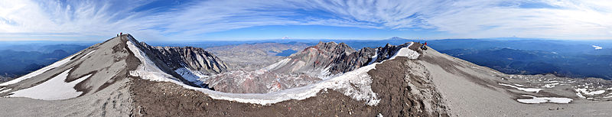
Mt. Saint Helens
Several hundred feet of stratified layers were formed
A 25 foot layer formed within a few hours (http://www.answersingenesis.org/articles/2010/05/18/thirtieth-anniversary-of-geologic-catastrophe)
Thousands of waterlogged trees sunk upright at the bottom of Spirit Lake (http://www.icr.org/article/261/)
Notes:
Mount Saint Helens when it erupted on May 18th had a total energy output of equivalent to 400 million tons of TNT or the equivalent of 20,000 Heroshima size A-bombs.
An estimation of 19,000 such trees were at the bottom of Spirit Lake in 1985. See next chart…

Slide 13
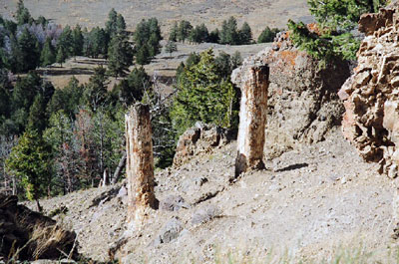
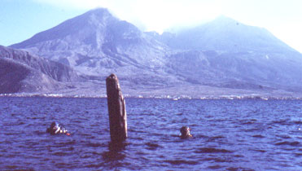
Comparison
A broken tree stump standing upright at the bottom of Spirit Lake after the eruption of Mount Saint Helens. In apparent growing position, but not growing location.
Images from Creation.com
Petrified trees in Yellowstone –similar style: in growing position, but not in growing location.
Notes:
http://creation.com/geology-and-the-young-earth
Doctor Steven A. Austin wrote, “ Scuba investigation of the upright deposited trunks shows that some are already solidly buried by sedimentation, with more than three feet of sediment around their bases, while others have no sediment around their bases. This proved that the upright trees were deposited at different times, with their roots buried at different levels. If found buried in the stratigraphic record, these trees might be interpreted as multiple forests which grew on different levels over periods of thousands of years. The Spirit Lake upright deposited stumps, therefore, have considerable implications for interpreting "petrified forests" in the stratigraphic record” (http://www.icr.org/article/261/)

Slide 14
The Holy Spirit
(2 Pet. 3:3-6)
3 knowing this first: that scoffers will come in the last days, walking according to their own lusts,
4 and saying, "Where is the promise of His coming? For since the fathers fell asleep, all things continue as they were from the beginning of creation."
5 For this they willfully forget: that by the word of God the heavens were of old, and the earth standing out of water and in the water,
6 by which the world that then existed perished, being flooded with water.

Slide 15
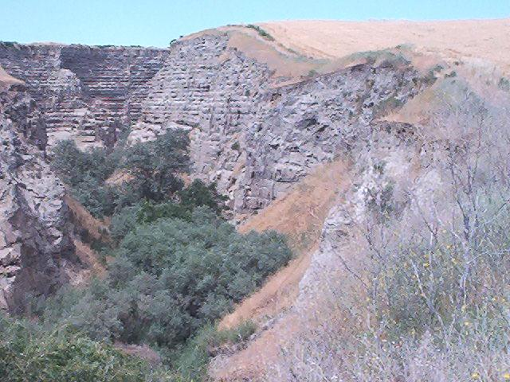

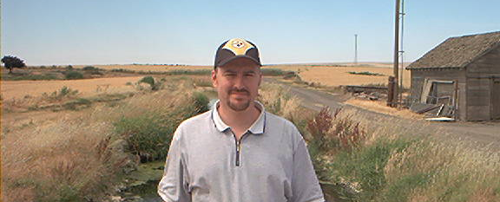
“Noah's flood was only about a year long.”
Burlingame
Canyon: scientific observation from a ditch to a canyon in six days!
From a ditch to a canyon!
Photo: 2003
Notes:
“In 1904, the Gardena Farming District constructed a series of irrigation canals to provide water to this normally rather arid high desert area. In March 1926, winds collected tumbleweeds at a concrete constriction along one of the canals situated on an elevated mesa, choking the flow of water, which at 2 m³(80 cubic ft) per second was unusually high due to spring rains. To clean out the obstruction, engineers diverted the flow into a diversion ditch leading to nearby Pine Creek. Before this, the ditch was rather small, at no location greater than 3 m (10 ft) deep and 1.8 m (6 ft) wide, and often with no water in it at all.
The abnormally high flow crowded into the ditch and careened along until it cascaded down the mesa in an impressive waterfall. Suddenly, under this extreme pressure and velocity, the underlying stratum gave way and headward erosion began in earnest. What once was an insignificant ditch became a gully. The gully became a gulch. The gulch became a miniature Grand Canyon” (John Morris, Creation Magazine, Sept. 1, 2002).

Slide 16
Hill Roberts, “Flood Geology” (email message, 03, 1996)
“The scale of post-flood change assumed by flood geology would be equivalent to being transported to a foreign planet…virtually nothing would be the same. There is no indication at all that what Noah saw was radically different. The incidents on Mt. Ararat indicate conversely that the physical features of the newly washed world were recognizably similar to the pre-flood world. Geologically, the flood of Noah was very short, a mere hiccup-… It would not be likely that such an event would leave much of any geological record”
Notes:
So Burlingame canyon was radically different after six days, but Noah’s world would not be radically different from a global flood? Now who is making spurious commentary?

Slide 17
A mere hiccup?
“So the LORD said, ‘I will destroy man whom I have created from the face of the earth, both man and beast, creeping thing and birds of the air, for I am sorry that I have made them’” (Gen. 6:7)
“And God said to Noah, ‘The end of all flesh has come before Me, for the earth is filled with violence through them; and behold, I will destroy them with the earth’” (Gen. 6:13)

Slide 18
A mere hiccup?
“And behold, I Myself am bringing floodwaters on the earth, to destroy from under heaven all flesh in which is the breath of life; everything that is on the earth shall die” (Gen. 6:17)
“For after seven more days I will cause it to rain on the earth forty days and forty nights, and I will destroy from the face of the earth all living things that I have made.” (Gen. 7:4)

Slide 19
A mere hiccup?
“In the six hundredth year of Noah’s life, in the second month, the seventeenth day of the month, on that day all the fountains of the great deep were broken up, and the windows of heaven were opened. And the rain was on the earth forty days and forty nights” (Gen. 7:11, 12)
“Now the flood was on the earth forty days. The waters increased and lifted up the ark, and it rose high above the earth” (Gen. 7:17)

Slide 20
A mere hiccup?
“And the waters have been very very mighty on the earth, and covered are all the high mountains which are under the whole heavens; fifteen cubits upwards have the waters become mighty, and the mountains are covered” (Gen. 7:19, 20, YLT)
What is spurious about believing in a global changing flood?

Slide 21
“It would not be likely that such an event would leave much of any geological record?”
Something that covers all the mountains
Something that destroys all the flesh on the earth
Something that produced massive mountain formation
Something that formed deep valley recesses

Slide 22
“It would not be likely that such an event would leave much of any geological record?”
If there had been a flood that covered all the world, destroyed all flesh, and caused the mountains to rise and the valleys to sink, what would we expect to see in our world
  Billions of dead things buried in rock layers all over the earth
  Extremely high mountains
  Extremely deep canyons/valleys
Notes:
The difference from today’s highest point on earth to the lowest oceanic depth is about 12 miles!

Slide 23
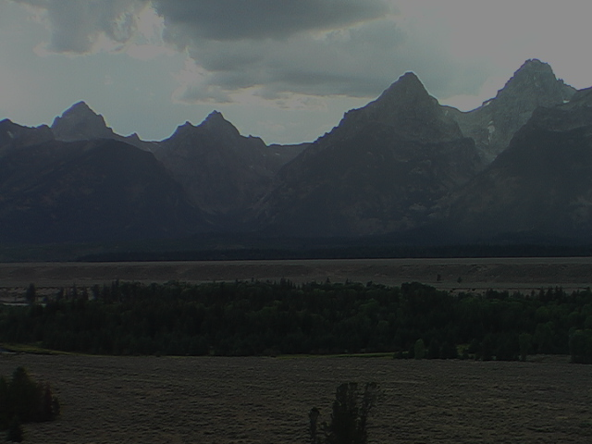
Psalms Tied To The Genesis Flood
6 you covered it with the deep as with a garment; the waters were standing above the mountains.
7 at your rebuke they fled, at the sound of your thunder they hurried away.
8 the mountains rose; the valleys sank down to the place which you established for them.
9 you set a boundary that they may not pass over, so that they will not return to cover the earth”
(Ps. 104:6-9, NASB)

Slide 24
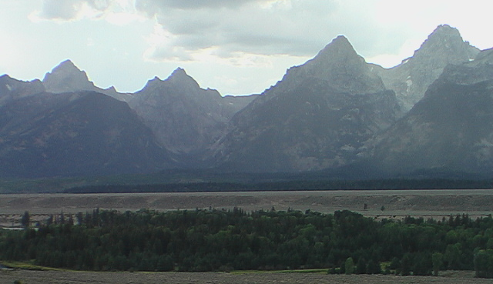
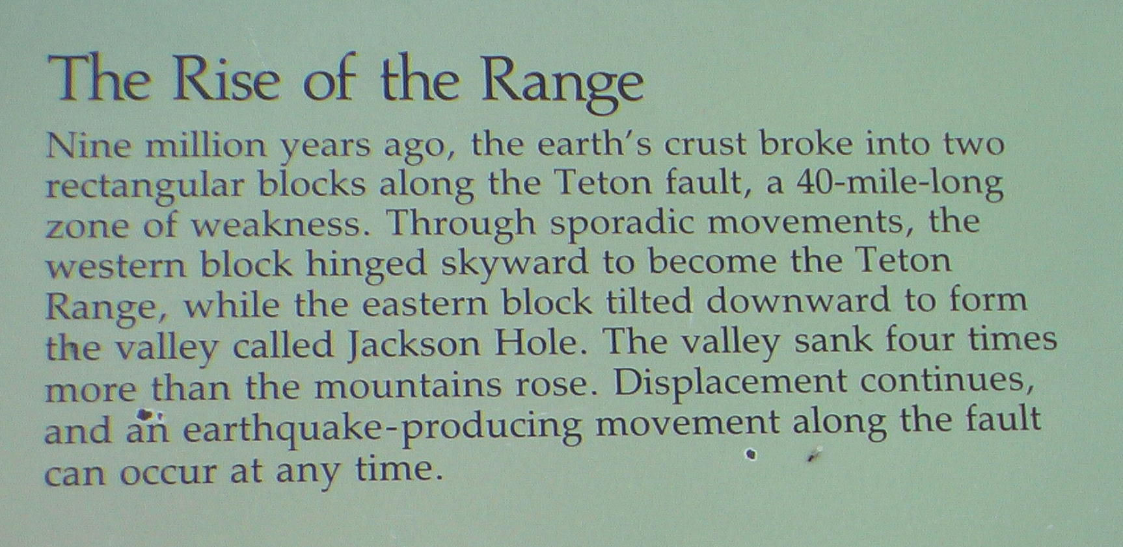
Photo of Sign: Grand Teton National Park
Notes:
Fact and fiction. They cannot break away from millions of years but recognize something, likely unknown to them, which the bible taught 1000 years before Christ, that the valleys sank and the mountains rose. As per the time, I simply ask what God asked Job, “Where were you when I laid the foundations of the earth? Tell Me, if you have understanding” (38:4)

Slide 25
Genesis Flood Connected To The End
37 "But as the days of Noah were, so also will the coming of the Son of Man be.
38 "For as in the days before the flood, they were eating and drinking, marrying and giving in marriage, until the day that Noah entered the ark,
39 "and did not know until the flood came and took them all away, so also will the coming of the Son of Man be.
--Matthew 24:37-39
Notes:
If the Genesis flood was a mere hiccup, then I supposed it is natural to conclude the coming of the Son of Man will also be a mere hiccup.

Slide 26
Open Acceptance of Long Ages
“However, suffice it to say that students of these fields accept these evidences and reject the idea that the universe, the earth, and man are all only about 6,000 to 10,000 years old. Long ages are not just accepted in order to provide enough time for organic evolution. Rather, it is just the most natural and simplest interpretation of the physical evidence based on current understanding of chemistry and physics”
(Hill Roberts, Genealogy and Chronology, 1994, revised)

Slide 27
Open Acceptance of Long Ages
“If the theory of organic evolution had never existed, these studies would still have reached essentially the same conclusions about ancient times. Much of the geological evidence for long ages had already lead to such conclusions prior to Darwin's theories. In fact, this allowed Darwin to think about what might happen over such long time frames, not the other way around” (ibid.)
  Affirms long ages were a far gone conclusion independent of Darwin
  Admits that long ages played a part in Darwin’s formulation of organic evolution
  Did not bother him as he sought to captivate young impressionable minds with long age conjectures!

Slide 28
Proverbs 30:5, 6
Every word of God is pure; He is a shield to those who put their trust in Him.
Do not add to His words, Lest He rebuke you, and you be found a liar.

